Slide 1


Data Storage Android
Speaker:
Andrii Rudyk

Slide 2

Data and file storage overview
Android provides several options for you to save your app data. The solution you choose depends on your specific needs, such as how much space your data requires, what kind of data you need to store, and whether the data should be private to your app or accessible to other apps and the user:
Internal file storage: Store app-private files on the device file system.
External file storage: Store files on the shared external file system. This is usually for shared user files, such as photos.
Shared preferences: Store private primitive data in key-value pairs.
Databases: Store structured data in a private database.

Slide 3
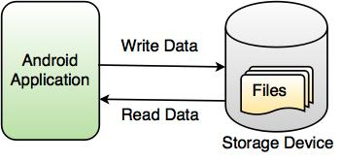
Internal storage
Internal storage is the storage of the private data on the device memory. By default these files are private and are accessed by only your application and get deleted , when user delete your application.

Slide 4
Internal storage
Your app's internal storage directory is specified by your app's package name in a special location of the Android file system that can be accessed with the following APIs
When saving a file to internal storage, you can acquire the appropriate directory as a File by calling one of two methods:
getFilesDir() - returns a File representing an internal directory for your app.
getCacheDir() - returns a File representing an internal directory for your app's temporary cache files.
val FILENAME = "hello_file"
val string = "hello world!"
val fos = openFileOutput(FILENAME, Context.MODE_PRIVATE)
fos.write(string.toByteArray())
fos.close()
val file = openFileInput(FILENAME)
val inputString = file.read()
file.close()

Slide 5
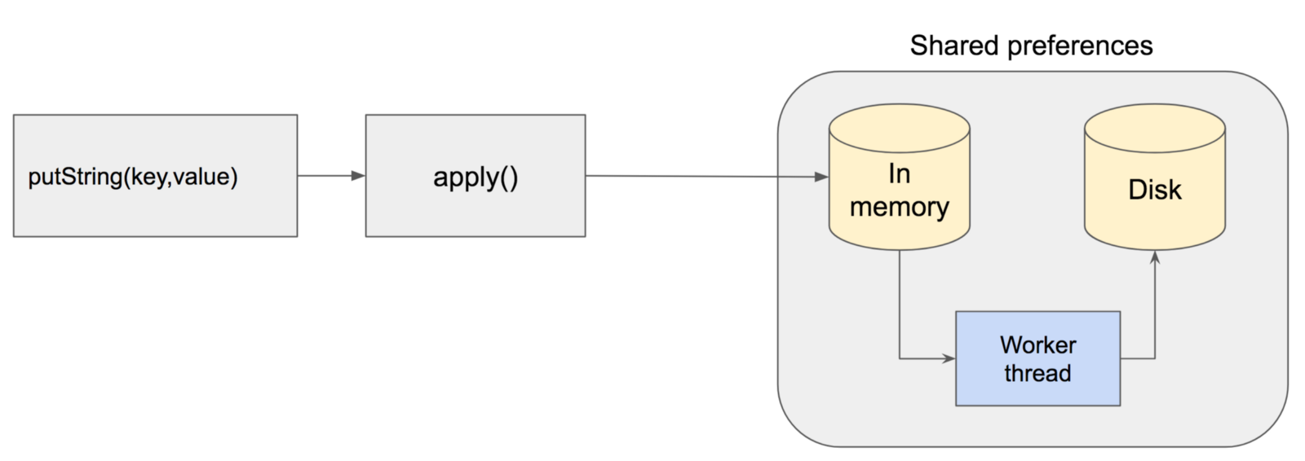
Shared Preferences
Shared Preferences allow you to save and retrieve data in the form of key,value pair.
In order to use shared preferences, you have to call a method getSharedPreferences() that returns a SharedPreference instance pointing to the file that contains the values of preferences.

Slide 6
Shared Preferences
You can create a new shared preference file or access an existing one by calling one of these methods:
getSharedPreferences() — Use this if you need multiple shared preference files identified by name, which you specify with the first parameter. You can call this from any Context in your app.
val sharedPref = activity?.getSharedPreferences(getString(R.string.preference_file_key), Context.MODE_PRIVATE)
getPreferences() — Use this from an Activity if you need to use only one shared preference file for the activity. Because this retrieves a default shared preference file that belongs to the activity, you don't need to supply a name.
val sharedPref = activity?.getPreferences(Context.MODE_PRIVATE)

Slide 7
Shared Preferences
To write to a shared preferences file, create a SharedPreferences.Editor by calling edit() on your SharedPreferences. Pass the keys and values you want to write with methods such as putInt() and putString(). Then call apply() or commit() to save the changes. For example:
val sharedPref = activity?.getPreferences(Context.MODE_PRIVATE) ?: return
with (sharedPref.edit()) {
putInt(key, newHighScore)
commit()
}
To retrieve values from a shared preferences file, call:
val highScore = sharedPref.getInt(key, defaultValue)

Slide 8
SQLite
Android SQLite is a very lightweight database which comes with Android OS. Android SQLite combines a clean SQL interface with a very small memory footprint and decent speed. For Android, SQLite is “baked into” the Android runtime, so every Android application can create its own SQLite databases.
Once a database is created successfully its located in data/data//databases/ accessible from Android Device Monitor.
SQLite is a typical relational database, containing tables (which consists of rows and columns), indexes etc. We can create our own tables to hold the data accordingly. This structure is referred to as a schema.

Slide 9
SQLite - Schema and contract
One of the main principles of SQL databases is the schema: a formal declaration of how the database is organized. The schema is reflected in the SQL statements that you use to create your database.
A contract class is a container for constants that define names for URIs, tables, and columns.
object FeedReaderContract {
// Table contents are grouped together in an anonymous object.
object FeedEntry : BaseColumns {
const val TABLE_NAME = "entry"
const val COLUMN_NAME_TITLE = "title"
const val COLUMN_NAME_SUBTITLE = "subtitle"
}
}

Slide 10
SQLite - SQLiteOpenHelper
Android has features available to handle changing database schemas, which mostly depend on using the SQLiteOpenHelper class.
SQLiteOpenHelper is designed to get rid of two very common problems.
When the application runs the first time – At this point, we do not yet have a database. So we will have to create the tables, indexes, starter data, and so on.
When the application is upgraded to a newer schema – Our database will still be on the old schema from the older edition of the app. We will have option to alter the database schema to match the needs of the rest of the app.

Slide 11
SQLite - Create Database
Once you have defined how your database looks, you should implement methods that create and maintain the database and tables.
private const val SQL_CREATE_ENTRIES =
"CREATE TABLE ${FeedEntry.TABLE_NAME} (" +
"${BaseColumns._ID} INTEGER PRIMARY KEY," +
"${FeedEntry.COLUMN_NAME_TITLE} TEXT," +
"${FeedEntry.COLUMN_NAME_SUBTITLE} TEXT)"
private const val SQL_DELETE_ENTRIES = "DROP TABLE IF EXISTS ${FeedEntry.TABLE_NAME}"

Slide 12
SQLite - Create Database
class FeedReaderDbHelper(context: Context) : SQLiteOpenHelper(context, DATABASE_NAME, null, DATABASE_VERSION) {
override fun onCreate(db: SQLiteDatabase) {
db.execSQL(SQL_CREATE_ENTRIES)
}
override fun onUpgrade(db: SQLiteDatabase, oldVersion: Int, newVersion: Int) {
// This database is only a cache for online data, so its upgrade policy is
// to simply to discard the data and start over
db.execSQL(SQL_DELETE_ENTRIES)
onCreate(db)
}
override fun onDowngrade(db: SQLiteDatabase, oldVersion: Int, newVersion: Int) {
onUpgrade(db, oldVersion, newVersion)
}
companion object {
// If you change the database schema, you must increment the database version.
const val DATABASE_VERSION = 1
const val DATABASE_NAME = "FeedReader.db"
}
}

Slide 13
SQLite - Put Data Into Database
Insert data into the database by passing a ContentValues object to the insert() method:
// Gets the data repository in write mode
val db = dbHelper.writableDatabase
// Create a new map of values, where column names are the keys
val values = ContentValues().apply {
put(FeedEntry.COLUMN_NAME_TITLE, title)
put(FeedEntry.COLUMN_NAME_SUBTITLE, subtitle)
}
// Insert the new row, returning the primary key value of the new row
val newRowId = db?.insert(FeedEntry.TABLE_NAME, null, values)

Slide 14
SQLite - Read Data From Database
Insert data into the database by passing a ContentValues object to the insert() method:
val db = dbHelper.readableDatabase
val projection = arrayOf(BaseColumns._ID, FeedEntry.COLUMN_NAME_TITLE, FeedEntry.COLUMN_NAME_SUBTITLE)
val selection = "${FeedEntry.COLUMN_NAME_TITLE} = ?"
val selectionArgs = arrayOf("My Title")
val sortOrder = "${FeedEntry.COLUMN_NAME_SUBTITLE} DESC"
val cursor = db.query(
FeedEntry.TABLE_NAME, // The table to query
projection, // The array of columns to return (pass null to get all)
selection, // The columns for the WHERE clause
selectionArgs, // The values for the WHERE clause
null, // don't group the rows
null, // don't filter by row groups
sortOrder // The sort order
)

Slide 15
SQLite - Update Data Into Database
When you need to modify a subset of your database values, use the update() method.
val db = dbHelper.writableDatabase
// New value for one column
val title = "MyNewTitle"
val values = ContentValues().apply {
put(FeedEntry.COLUMN_NAME_TITLE, title)
}
// Which row to update, based on the title
val selection = "${FeedEntry.COLUMN_NAME_TITLE} LIKE ?"
val selectionArgs = arrayOf("MyOldTitle")
val count = db.update(
FeedEntry.TABLE_NAME,
values,
selection,
selectionArgs)

Slide 16

Thank you!
Notes:
Apk image sizes
App priority

